Slide 1

COS1512 – Online Class Session – 04 JUNE 2026
COS1512 – INTRODUCTION TO PROGRAMMING II – Using C++
Academic Year: 2026
Date: 11 JUNE 2026
Time: 17:00 PM to 19:00 PM

Slide 2
Topics
Chapter 7
Arrays

Slide 3
Contents
Introduction to Arrays
Declaring Arrays
Referencing Arrays

Slide 4
Introduction to Arrays
An array is a collection of a fixed number of components (also called elements) all of the same data type and in contiguous (that is, adjacent) memory space.
A one-dimensional array is an array in which the components are arranged in a list form.

Slide 5
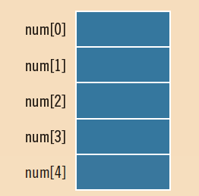
Declaring an Array
dataType arrayName[intExp];
The statement:
int num[5];
declares an array num of five components. Each component is of type int. The component names are num[0], num[1], num[2], num[3], and num[4].

Slide 6
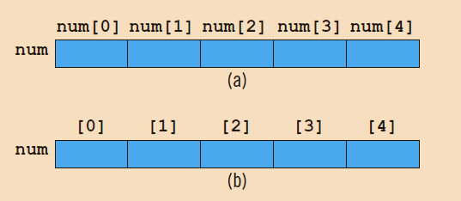
Declaring an Array

Slide 7
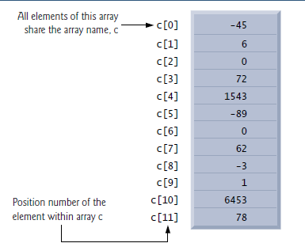
Referencing an Array

Slide 8
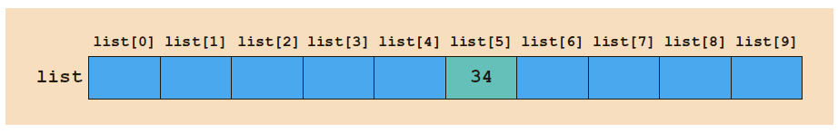
Accessing Array Components
The assignment statement:
list[5] = 34;
stores 34 in list[5], which is the sixth component of the array list.

Slide 9
Referencing an array
The position number in square brackets is called the element’s index or subscript. An index must be an integer or an integer expression. For example, the statement
c[2] = 1000;
assigns 1000 to array element c[2]. Similarly, if a = 5 and b = 6, then the statement
c[a + b] += 2;
adds 2 to array element c[11]. An indexed array name is an lvalue—it can be used on the
left side of an assignment.

Slide 10
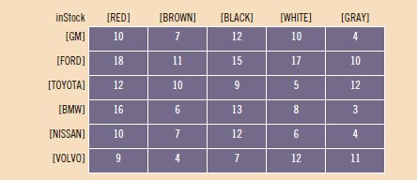
Two-and Multidimensional Arrays

Slide 11
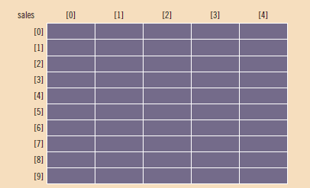
Two-and Multidimensional Arrays
dataType arrayName[intExp1][intExp2];
double sales[10][5];

Slide 12
Two-and Multidimensional Arrays
Suppose that:
int i = 5;
int j = 3;
Then, the previous statement:
sales[5][3] = 25.75;
is equivalent to:
sales[i][j] = 25.75;
So, the indices can also be variables.

Slide 13
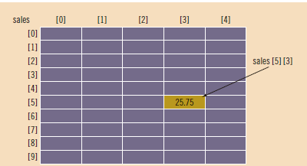
Two-and Multidimensional Arrays
Suppose that:
int i = 5;
int j = 3;
Then, the previous statement:
sales[5][3] = 25.75;
is equivalent to:
sales[i][j] = 25.75;
So, the indices can also be variables.

